Slide 1
PARTNER.SHIP.REDEFINED.
FIRE DURING HOT WORKS
PDB-10-000

Slide 2
CASE: FIRE DURING HOT WORKS
When : 10-02-2020
Where: at Sea

Slide 3
CASE: FIRE DURING HOT WORKS
COURSE OF EVENTS
On 09-02-2020 was found that hydraulic pipe of stbd mooring winch is leaking
10th of February oil was drained from the stbd mooring winch hydraulic system and area was prepared for hot work
15:35 - Commence of hot works to dismount the old leaking pipe.
16:10 - Ch.Officer(st-by person) reported that "fire in the forecastle switch room"
16:12 - Attempt to extinguish the fire with fire extinguishers with no positive result.
16:15 - Crew on st-by, ventilation/fire flaps closed, electrical supply of the forecastle switched off.
16:28 – Fire squad reached the centre of fire fighting area (switch room).
16:36 - Fire completely extinguished. All men out and safe.

Slide 4
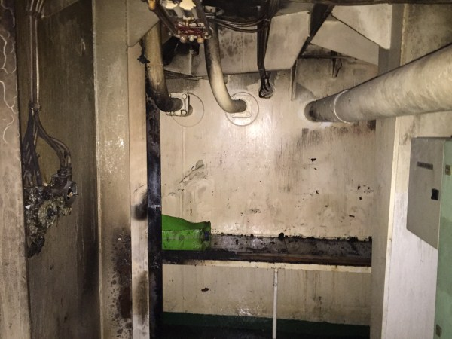
CASE: FIRE DURING HOT WORKS
WHY THIS HAPPENED
Main cause of fire was that crew overlooked fact that the ceiling and the wall had partly an oily surface. The spark reached the oily area and later fire jumped to the stored, used safety equipment (old fire box and used fire hoses) which was not moved out from the working area far enough.

Slide 5
CASE: FIRE DURING HOT WORKS
HOW THIS COULD BE PREVENTED ?
Risk asessment prior starting of works
Proper preparation of area where hot works will be done – removal of flammable materials.
Fire extinguisher available next to hot works area
Exact check of arrangements by superiors
(All points are part of HOT WORK PERMIT PROCEDURE)
HOT WORK PERMIT

Slide 6
THANK YOU!

